Slide 1
God’s Up to Something
IN THIS PLACE

Slide 2
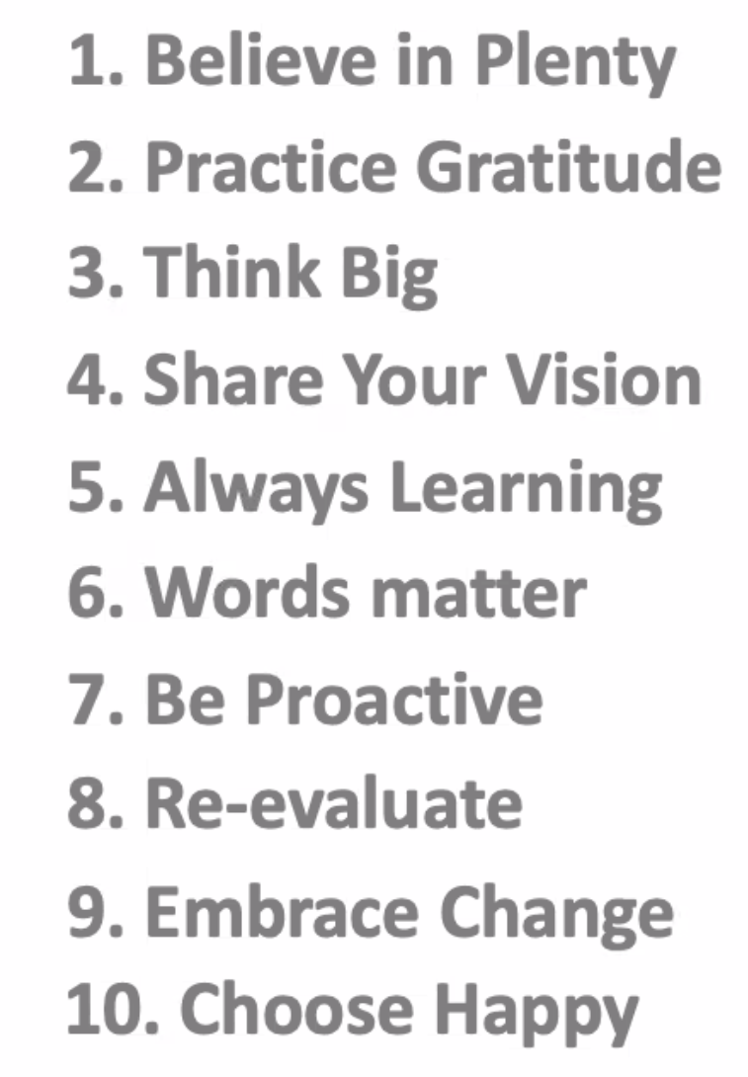
Brainstorming in a Group
First session: Practicing Gratitude
Second session: Possibilities
Today’s session: God is Up to Something – in this Place
Abundance list provided by Tina Kvitek

Slide 3
Where We Are Today
Slide provided by Tina Kvitek

Slide 4
ZOOM OUT
IN A CHANGING WORLD
Strategic planning key to making changes
Partners are critical
Let things die so more impactful programs can rise
Do with excellence, not everything.
Slide provided by Mike Ward

Slide 5
ZOOM OUT : TABLE QUESTIONS
Now that we’ve had a month to think about it and using the recommendations on the previous two slides:
If we create a new strategic plan, how far out are we envisioning?
What things aren’t as important anymore? And to whom?
What things are? And to whom?
Who might our partners be?

Slide 6
ZOOM IN
Those with us are fully committed.
STP: Same Ten People
Invite people into Outcome.

Slide 7
ZOOM IN: TABLE QUESTIONS
If you consider US: those STP that will be fully committed:
What would you recommend?
Add in Outcome: What would it mean to invite people – not just us – to outcome possibilities?

Slide 8
HIT PAUSE
Be story makers, not just story tellers. She emphasizes that stories give us guidance to recognize the world as a gift and to think how we might respond.
~ Robin Wall Kimmerer, Braiding Sweetgrass author, MacArthur Genius Award winner

